Slide 1
CS6382 Algorithm Analysis and Game Theory ApproximatioN Algorithms Adapted from Bo Li’s slides

Slide 2
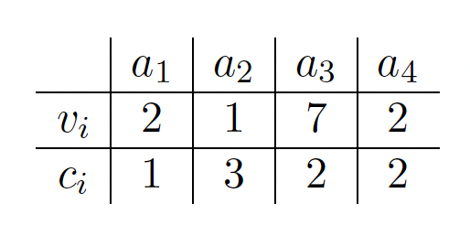
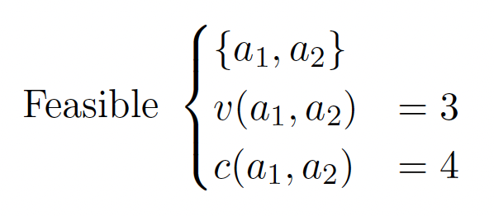
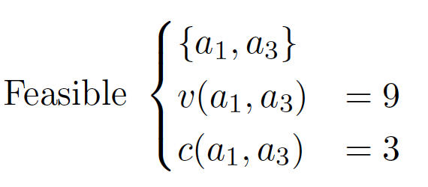
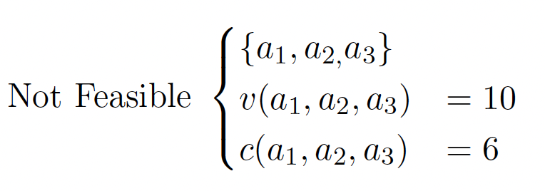
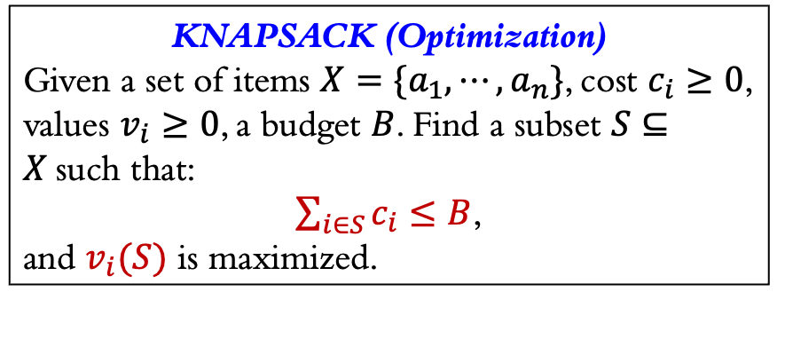
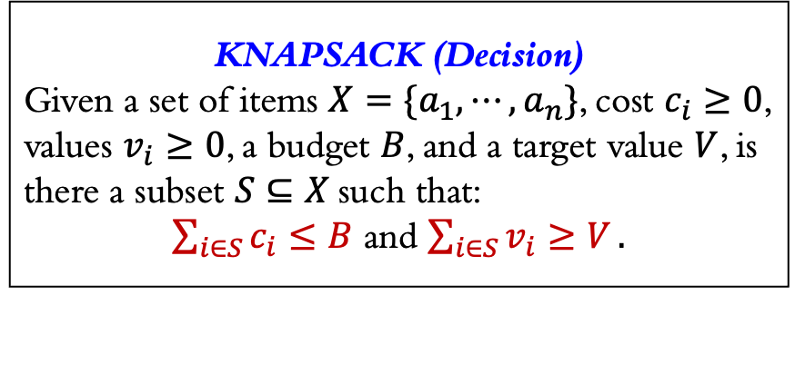
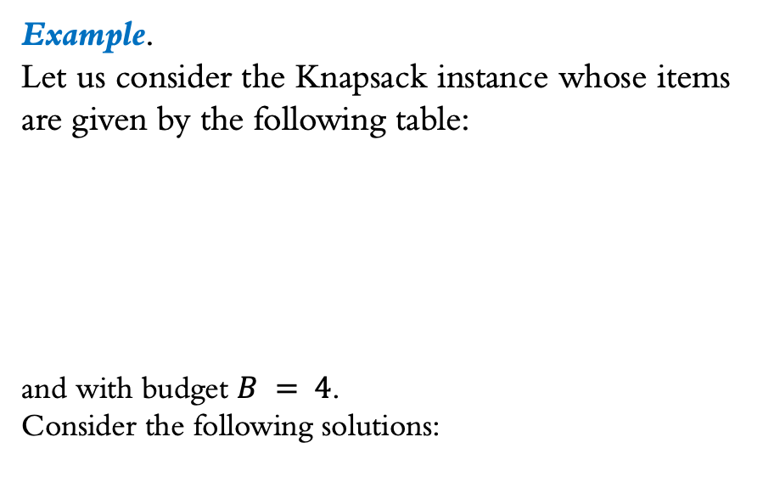
KNAPSACK (Decision)
Given a set of items $X=\{a_{1},⋯,a_{n}\}$, cost $c_{i}≥0$, values $v_{i}≥0$, a budget $B$, and a target value $V$, is there a subset $S⊆X$such that:
$\sum_{i∈S}{c_{i}≤B}$ and $\sum_{i∈S}{v_{i}≥V}.$
Example.
Let us consider the Knapsack instance whose items are given by the following table:
and with budget $B = 4$.
Consider the following solutions:
KNAPSACK (Optimization)
Given a set of items $X=\{a_{1},⋯,a_{n}\}$, cost $c_{i}≥0$, values $v_{i}≥0$, a budget $B$. Find a subset $S⊆X$such that:
$\sum_{i∈S}{c_{i}≤B}$,
and $v_{i}(S)$ is maximized.
The second solution is better because its value is larger. In fact, it has maximum value among all feasible solutions.

Slide 3
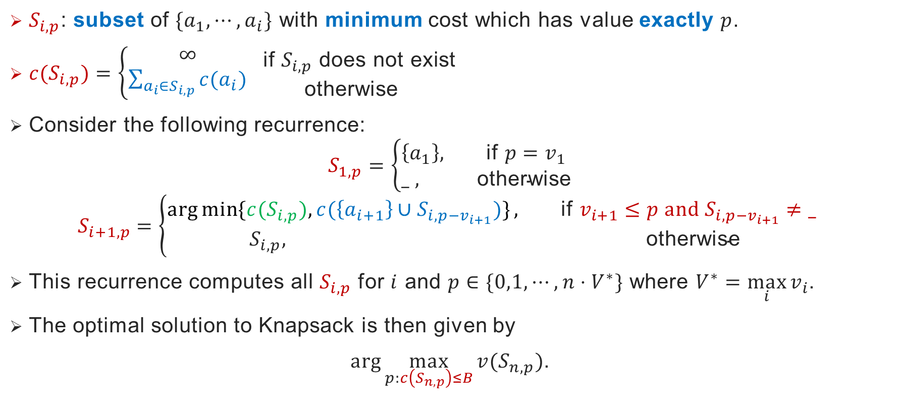
Dynamic Programming Algorithm for Knapsack
$S_{i,p}$: subset of $\{a_{1},⋯,a_{i}\}$ with minimum cost which has value exactly $p$.
${c(S}_{i,p})=\left\{\begin{matrix}∞ \\ \sum_{a_{i}∈S_{i,p}}{c(a_{i})}\end{matrix}\begin{aligned} \text{if} S_{i,p} \text{does} \text{not} \text{exist} \\ \text{otherwise} \end{aligned}\right.$
Consider the following recurrence:
$$S_{1,p}=\left\{\begin{aligned}\left\{a_{1}\right\}, \text{if} p=v_{1} \\ _ , \text{otherwise}\end{aligned}\right.$$
$$S_{i+1,p}=\left\{\begin{aligned}\arg{\min{\{{c(S}_{i,p}), c(\left\{a_{i+1}\right\}∪S_{i,p−v_{i+1}})\}}}, \text{if} v_{i+1}≤p and S_{i,p−v_{i+1}}≠\text{_} \\ &S_{i,p}, \text{otherwise}\end{aligned}\right.$$
This recurrence computes all $S_{i,p}$ for $i$ and $p∈\{0,1,⋯,n⋅V^{∗}\}$ where $V^{∗}=\max_{i}{v_{i}}$.
The optimal solution to Knapsack is then given by
$\arg{\max_{p:c\left(S_{n,p}\right)≤B}{v(S_{n,p})}}$.

Slide 4
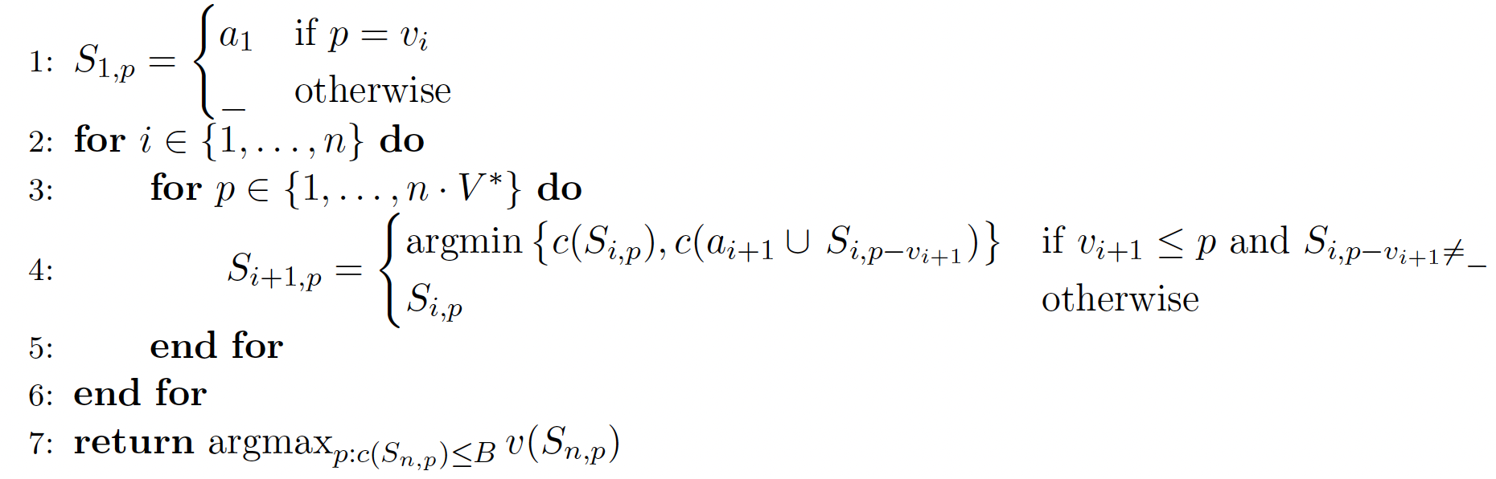
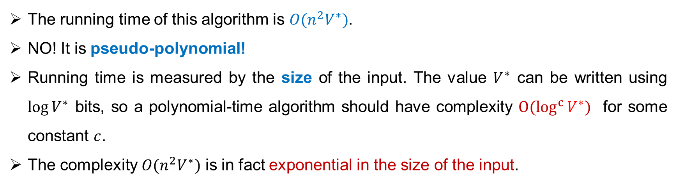
Dynamic Programming Algorithm for Knapsack
polynomial time algorithm?
The running time of this algorithm is $O(n^{2}V^{∗})$.
NO! It is pseudo-polynomial!
Running time is measured by the size of the input. The value $V^{∗}$ can be written using $log⁡V^{∗}$ bits, so a polynomial-time algorithm should have complexity $O(\log^{c}{V^{∗}})$ for some constant $c$.
The complexity $O(n^{2}V^{∗})$ is in fact exponential in the size of the input.
number of bits

Slide 5
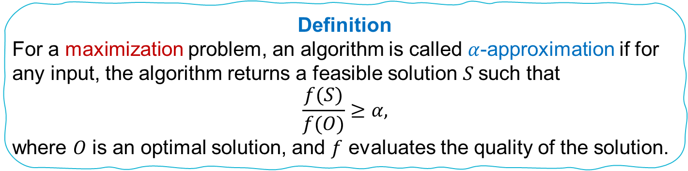
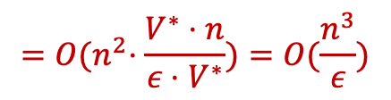
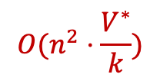
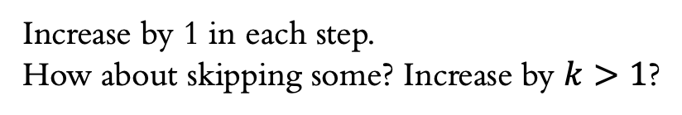
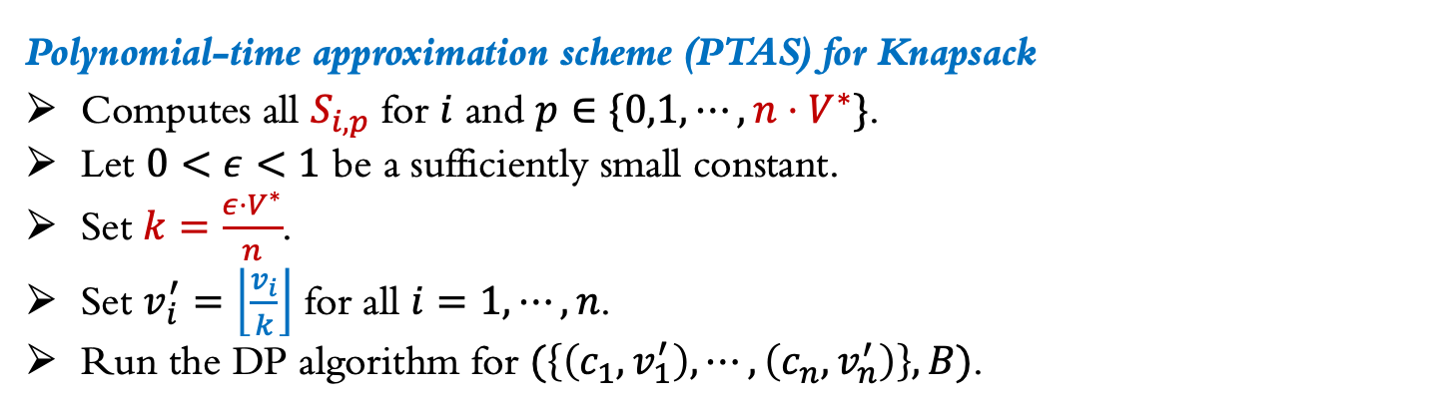
Approximation Algorithm
Even though the DP algorithm is not polynomial, it can be transformed into a polynomial-time approximation algorithm with arbitrarily good approximation ratio.
Definition
For a maximization problem, an algorithm is called $α$-approximation if for any input, the algorithm returns a feasible solution $S$such that
$$\frac{f(S)}{f(O)}≥α,$$
where $O$ is an optimal solution, and $f$ evaluates the quality of the solution.
Polynomial-time approximation scheme (PTAS) for Knapsack
Computes all $S_{i,p}$ for $i$ and $p∈\{0,1,⋯,n⋅V^{∗}\}$.
Let $0<ε<1$ be a sufficiently small constant.
Set $k=\frac{ε⋅V^{∗}}{n}$.
Set $v_{i}^{′}=\left\lfloor \frac{v_{i}}{k}\right\rfloor$ for all $i=1,⋯,n$.
Run the DP algorithm for $(\left\{\left(c_{1},v_{1}^{′}\right), ⋯,\left(c_{n},v_{n}^{′}\right)\right\},B)$.
Increase by 1 in each step.
How about skipping some? Increase by $k>1$?
$${O(n}^{2}⋅\frac{V^{∗}}{k})$$
$${=O(n}^{2}⋅\frac{V^{∗}⋅n}{ε⋅V^{∗}})=O(\frac{n^{3}}{ε})$$
How far away from the optimal solution?

Slide 6
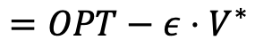
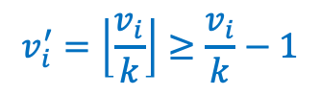
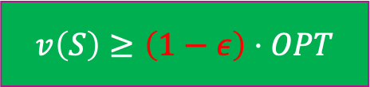
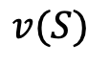
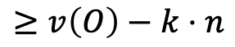
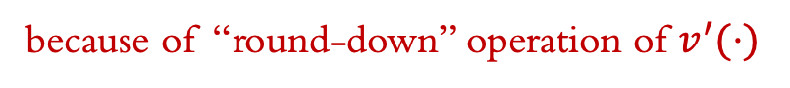
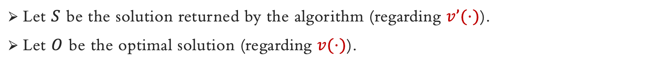

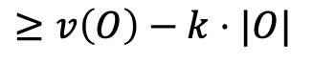
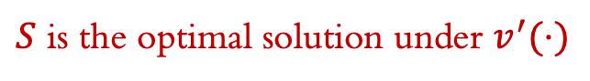
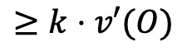
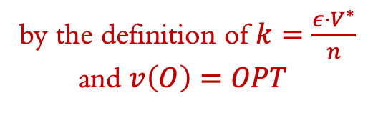
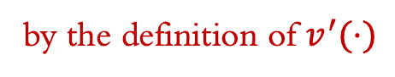
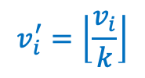
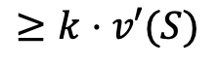
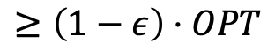
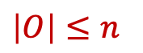
Approximation Ratio
Let $S$ be the solution returned by the algorithm (regarding 𝑣’(⋅)).
Let $O$ be the optimal solution (regarding 𝑣(⋅)).
Without loss of generality, we can assume $c_{i}≤B$ for all $a_{i}$.
$S$ is the optimal solution under $v^{′}(⋅)$
$\left|O\right|≤n$
$$OPT≥V^{∗}$$
$$v(S)$$
$$≥k⋅v′(S)$$
$$≥k⋅v′(O)$$
$$≥v\left(O\right)−k⋅|O|$$
$$≥v\left(O\right)−k⋅n$$
$$=OPT−ε⋅V^{∗}$$
$$≥\left(1−ε\right)⋅OPT$$
by the definition of $k=\frac{ε⋅V^{∗}}{n}$
and $v\left(O\right)=OPT$
by the definition of $v^{′}(⋅)$
$$v_{i}^{′}=\left\lfloor \frac{v_{i}}{k}\right\rfloor$$
because of “round-down” operation of $v^{′}(⋅)$
$$v\left(S\right)≥\left(1−ε\right)⋅OPT$$
$$v_{i}^{′}=\left\lfloor \frac{v_{i}}{k}\right\rfloor ≥\frac{v_{i}}{k}−1$$

Slide 7
A Few More Definitions

Slide 8
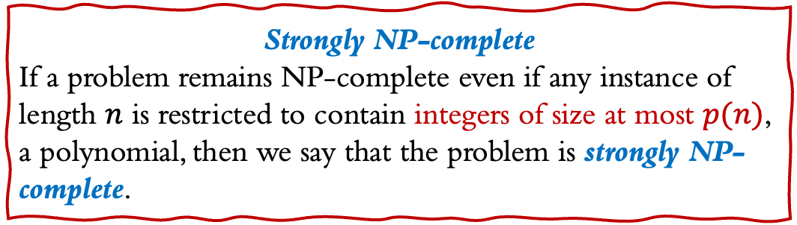
Strong NP-completeness
The pseudo-polynomial algorithm does not establish that P = NP!
The NP-completeness proof for SUBSET-SUM, KNAPSACK and PARTITION uses exponentially large integers.
Problems including VERTEX-COVER, SET-COVER, INDEPENDET-SET, were shown NP-complete via reductions that constructed only polynomially small integers.
Strongly NP-complete
If a problem remains NP-complete even if any instance of length $n$ is restricted to contain integers of size at most $p(n)$, a polynomial, then we say that the problem is strongly NP-complete.

Slide 9
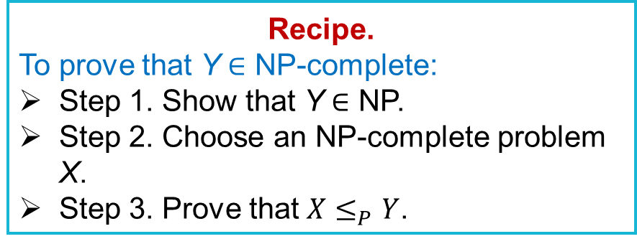
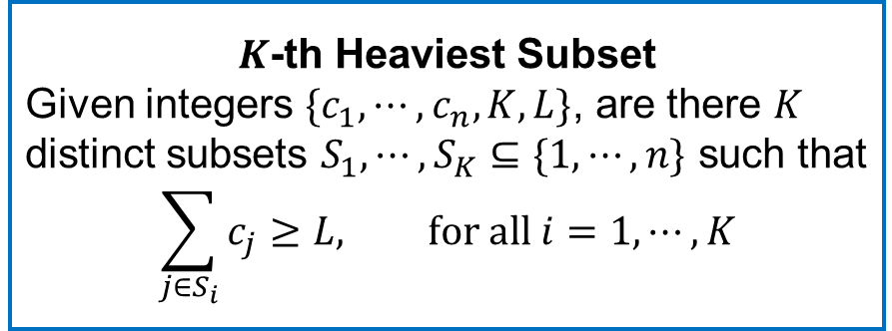
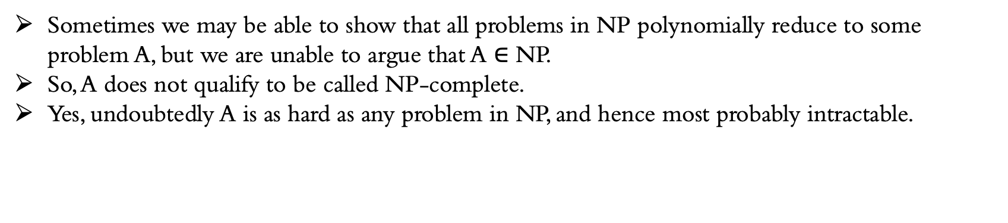
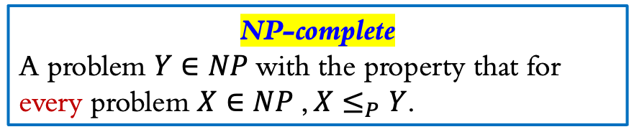
NP-hard
Recipe.
To prove that Y ∈ NP-complete:
Step 1. Show that Y ∈ NP.
Step 2. Choose an NP-complete problem X.
Step 3. Prove that $X≤_{P}Y$.
NP-complete
A problem $Y∈NP$with the property that for every problem $X∈NP$, $X≤_{P}Y$.
Sometimes we may be able to show that all problems in NP polynomially reduce to some problem A, but we are unable to argue that A $∈$ NP.
So, A does not qualify to be called NP-complete.
Yes, undoubtedly A is as hard as any problem in NP, and hence most probably intractable.
NP-hard
$K$-th Heaviest Subset
Given integers $\{c_{1},⋯,c_{n},K,L\}$, are there $K$ distinct subsets $S_{1},⋯,S_{K}⊆\{1,⋯,n\}$ such that
$$\sum_{j∈S_{i}}{c_{j}≥L, for all i=1,⋯,K}$$
The term NP-hard is also used in the literature to describe optimization problems (which are not decision problems and thus not in NP).

Slide 10
Vertex Cover Problem

Slide 11
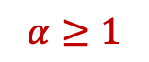
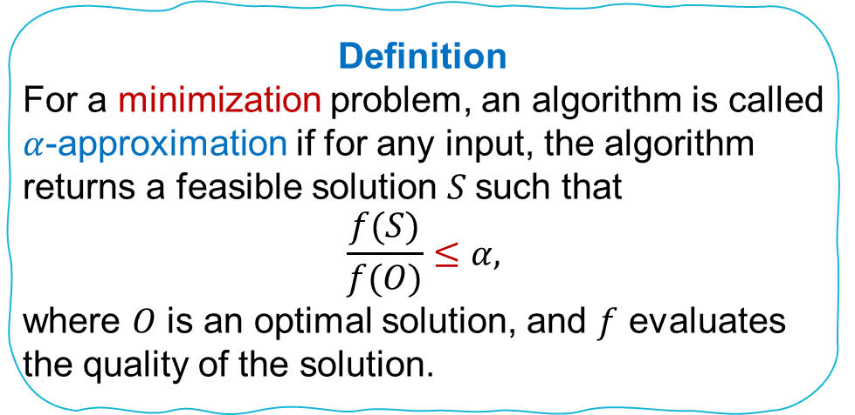
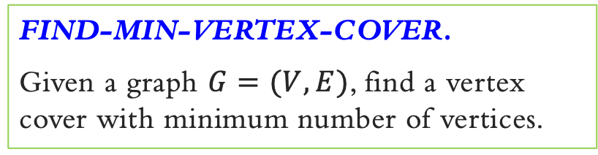
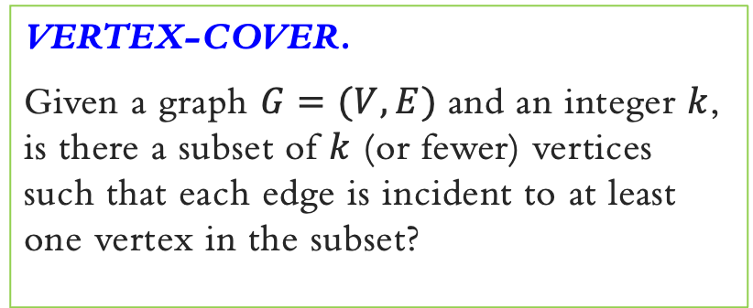
Vertex Cover Problem
VERTEX-COVER.
Given a graph $G=(V, E)$and an integer $k$, is there a subset of $k$ (or fewer) vertices such that each edge is incident to at least one vertex in the subset?
FIND-MIN-VERTEX-COVER.
Given a graph $G=(V, E)$, find a vertex cover with minimum number of vertices.
Definition
For a minimization problem, an algorithm is called $α$-approximation if for any input, the algorithm returns a feasible solution $S$such that
$$\frac{f(S)}{f(O)}≤α,$$
where $O$ is an optimal solution, and $f$ evaluates the quality of the solution.
$$α≥1$$
NP-hard
Approximation Algorithm!

Slide 12
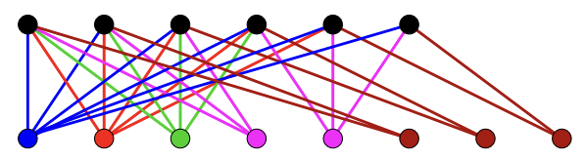
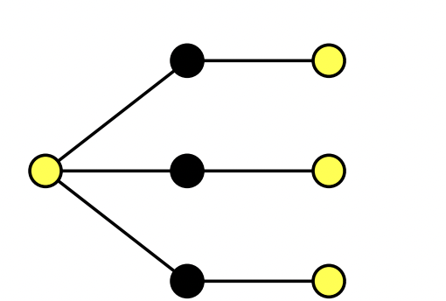
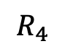

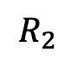
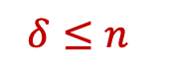
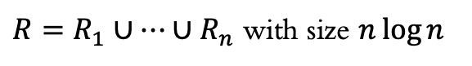
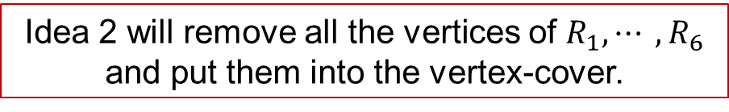
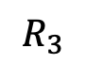
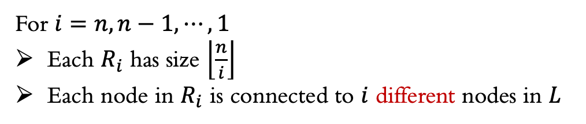
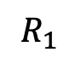





$$δ≤n$$
Vertex Cover Problem
$L$ with size $n$
Idea 1.
Pick an arbitrary vertex with at least one uncovered edge incident to it, put it into the cover, and repeat.
$$R_{6}$$
$$R_{5}$$
$$R_{4}$$
$$R_{3}$$
$$R_{2}$$
$$R_{1}$$
Idea 2.
How about picking the vertex that covers the most uncovered edges?
$R=R_{1}∪⋯∪R_{n}$ with size $n\log{n}$
$$δ_{n}=n$$
$$δ_{n−2}=n−2$$
$$δ_{n−1}=n−1$$
For $i=n,n−1,⋯,1$
Each $R_{i}$ has size $\left\lfloor \frac{n}{i}\right\rfloor$
Each node in $R_{i}$ is connected to $i$ different nodes in $L$
Idea 2 will remove all the vertices of $R_{1},⋯ ,R_{6}$ and put them into the vertex-cover.
Cannot be better than $Ω(\log{n})$-approximation!

Slide 13


Vertex Cover Problem
Observation: The set of edges M picked by Algorithm 1 is a matching, i.e., no 2 edges touch each other (edge disjoint).
Algorithm 1.
Pick an arbitrary edge.
We know any vertex cover must have at least 1 endpoint of it, so let us take both endpoints.
Then, remove all edges covered and repeat until there are no uncovered edges left.
Claim 1: This algorithm gives a vertex cover.
Claim 2: This vertex cover has size no more than twice of the minimum size (optimal solution).
Proof
The optimum vertex cover must cover every edge in $M$. So, it must include at least one of the endpoints of each edge ∈ M, where no 2 edges in M share an endpoint.
$$OPT≥|M|$$
But Algorithm 1 returns a vertex cover of size 2|M|, so for any instance $I$, we have
$$ALG=2\left|M\right|≤2OPT$$
Theorem. Algorithm 1 is 2-approximation algorithm.

Slide 14





Integer linear programming formulation
Model inclusion of vertex $i$ using a 0/1 variable $x_{i}$:
Vertex covers is 1–1 correspondence with 0/1 assignments: $S=\{i∈V: x_{i}=1\}$.
Objective function:
Minimize $\sum_{i}{w_{i}⋅x_{i}}$
Constraints: For every edge $(i, j)$, must take either vertex $i$ or $j$ (or both):
$$x_{i}+x_{j}≥1$$
Weighted Vertex Cover Problem
Weighted Vertex-Cover.
Given a graph $G=(V, E)$and each vertex $i∈V$ has a weight $w_{i}≥0$. Find a min-weight subset of vertices $S⊆V$such that every edge is incident to at least one vertex in $S$.
3
1
1
3
If $x^{∗}$ is the optimal solution to ILP, then
$S=\{i∈V:x_{i}^{∗}=1\}$ is a min-weight vertex cover.
1
3
1

Slide 15



Integer Linear Programming
Linear Programming
Given integers $a_{ij}, b_{i}$, $c_{j}$, find integers $x_{j}$ that satisfy:
Find real numbers $x_{j}$ that satisfy:
Known Algorithms
Simplex algorithm. [Dantzig 1947] Can solve LP in practice.
Ellipsoid algorithm. [Khachiyan 1979] Can solve LP in poly-time.
Interior point algorithms. [Karmarkar 1984, Renegar 1988, … ] Can solve LP both in poly-time and in practice.
Theorem.
Vertex cover formulation proves that INTEGER-PROGRAMMING is an NP-hard optimization problem.

Slide 16






Weighted Vertex Cover Problem
Linear programming relaxation
Lemma.
Optimal value of LP ≤ optimal value of ILP.
$$OPT_{LP}≤OPT_{ILP}$$
Proof. LP has fewer constraints.
LP solution $x^{∗}$ may not correspond to a vertex cover.
(even if all weights are 1)
How can solving LP help us to find a low-weight vertex cover?
Solve LP and round fractional values in $x^{∗}$.

Slide 17










Integer solution: $y_{i}=\left\{\begin{aligned}1, if i∈S or x_{i}^{∗}≥\frac{1}{2} \\ 0, if i∉S or x_{i}^{∗}<\frac{1}{2}\end{aligned}\right.$
LP Rounding Algorithm
Linear programming relaxation
Rounding
Given LP solution $x^{∗}$, Set
$$S=\left\{i∈V ∣ x_{i}^{∗}≥\frac{1}{2}\right\}.$$
Let $W\left(S\right)=\sum_{i∈S}{w_{i}}$.
LP solution $x^{∗}$ may not correspond to a vertex cover.
(even if all weights are 1)
Claim. $S$ is a vertex cover
For any edge $(i, j)∈E$, $x_{i}^{∗}+x_{j}^{∗}≥1$,
$x_{i}^{∗}≥\frac{1}{2}$ or $x_{j}^{∗}≥\frac{1}{2}$ or both
Proof. For any $(i, j)∈E$, at least one of $i, j$ is in $S$.
Claim. $W\left(S\right)≤2⋅OPT_{LP}$
$=\sum_{i∈V}{x_{i}^{∗}⋅w_{i}}$.
Theorem.
The rounding algorithm is a 2-approximation algorithm.
Proof. $\sum_{i∈V}{x_{i}^{∗}⋅w_{i}}≥\sum_{i∈S}{x_{i}^{∗}⋅w_{i}}$
$≥\frac{1}{2}\sum_{i∈S}{w_{i}}$.

Slide 18


Weighted Vertex Cover Problem
Result 1. [Dinur–Safra 2004]
If P ≠ NP, then no $ρ$-approximation algorithm for WEIGHTED-VERTEX-COVER for any $ρ<1.3606$ (even if all weights are 1).
Result 2. [Kohot–Regev 2008]
If *Unique Games Conjecture* is true, then no $(2−ε)$approximation algorithm for WEIGHTED-VERTEX-COVER for any $ε>0$.

Slide 19
Set Cover Problem Greedy comes back

Slide 20




Set Cover Problem
SET-COVER.
Given a set $X$ of elements (points), a collection $S$ of subsets of $X$, and an integer $k$, are there $≤k$ of these subsets whose union is equal to $X$?
FIND-MIN-SET-COVER.
Given a set $X$ of elements (points), a collection $S$ of subsets of $X$, find the fewest number of these subsets whose union is equal to $X$?
OPT=3
Greedy Algorithm
Pick the set that covers the most points.
Remove all the points covered.
Repeat.
What is ALG for this instance?

Slide 21


Greedy Algorithm ALG
Pick the set that covers the most points.
Remove all the points covered.
Repeat.
Set Cover Problem
OPT=3
What is the approximation ratio?
Cannot be better than $Ω(\log{n})$!!!
ALG=4

Slide 22



Set Cover Problem
Theorem.
If the optimal solution uses $k$ sets, the greedy algorithm finds a solution with at most $k⋅ln⁡n$ sets.
If lucky, we may choose one set in OPT and so there are actually $k−1$sets covering the remainder, but we can’t count on this.
Proof.
Since $OPT=k$, there must be a set that covers at least a $1/k$ fraction of the points.
ALG chooses the set that covers the most points, so it covers at least $1/k$ fraction of the points.
Therefore, after the first iteration, there are at most $n⋅(1−\frac{1}{k})$ points left.
Again, since $OPT=k$, there must be a set that covers at least a $1/k$ fraction of the remainder.
So, again, since ALG chooses the set that covers the most points remaining, after the 2nd iteration, there are at most $n⋅{\left(1−\frac{1}{k}\right)}^{2}$ points left.

Slide 23






Set Cover Problem
Theorem.
If the optimal solution uses $k$ sets, the greedy algorithm finds a solution with at most $k⋅ln⁡n$ sets.
Proof.
More generally, after $t$ rounds, there are at most $n⋅{\left(1−\frac{1}{k}\right)}^{t}$ points left.
After$t=k ln⁡n$ rounds, there are at most
points left, which means we must be done.
Result [Feige]
In fact, it has been proven that unless everything in NP can be solved in time $n^{O(log⁡log⁡n)}$, you can’t get better than $\left(1−ε\right)\ln{n}$for any constant $ε>0$.
$$n⋅{\left(1−\frac{1}{k}\right)}^{\operatorname{kln}{n}}$$
$$< n⋅{\left(\frac{1}{e}\right)}^{\ln{n}}$$
$= 1$

Slide 24
Independent Set

Slide 25








Independent Set Problem
Given a graph $G=(V, E)$ with $\left|V\right|=n$ and $\left|E\right|=m$. Find a set of maximum number of vertices such that no two are adjacent?
Intuition
Always select the node with minimum degree.
A Bad Example:
Greedy Algorithm
A complete graph with $n$ vertices
$$OPT=n$$
$$ALG=2$$
the subset of vertices adjacent to $v$ and $v$
$v_{i}$ is adjacent to all vertices in $K_{n}$

Slide 26


Independent Set Problem
Greedy Algorithm
Proof
Every time a vertex $v$ is picked by Greedy, at most $Δ$ vertices are removed.
So at the end at most $|S|·(∆+1)$ vertices have been removed.
All nodes have been removed:
$$n≤(∆ + 1)·|S|$$
That is
$$\left|S\right|≥\frac{n}{Δ+1}≥\frac{OPT}{Δ+1}$$
Theorem.
The Greedy Algorithm is $(∆+1)$-approximation for graphs with degree at most $∆$.

Slide 27
Knapsack Problem

Slide 28







Fractional View of Knapsack
An optimal solution to the relaxation:
Sort the items in decreasing order of densities. The density of element $i$ is defined by the ratio $v_{i}/c_{i}$(value per cost).
Add items to the solution one-by-one in this order as long as the sum of the costs does not exceed the budget.
For the first item $i$ which violates the budget, only add a fraction $x_{i}$ of it such that the budget constraint is tight:
$$x_{i}=\frac{B−\sum_{j<i}{c_{j}}}{c_{i}}$$
KNAPSACK (Optimization)
Given a set of items $X=\{a_{1},⋯,a_{n}\}$, cost $c_{i}≥0$, values $v_{i}≥0$, a budget $B$. Find a subset $S⊆X$such that:
$\sum_{i∈S}{c_{i}≤B}$,
and $v_{i}(S)$ is maximized.
Integer programming:
$x_{i}∈\{0,1\}$ indicates whether item $i$ is selected
Example:
item 1 has cost 1 and value 2
item 2 has cost $M$ and value $M$ (for some $M>2$)
the budget is $B=M$
$x_{1}=1$ and $x_{2}=\frac{M−1}{M}$
${0≤x}_{i}≤1$
Previous rounding technique does not work

Slide 29











Greedy Algorithm of Knapsack
$$OPT≤OPT_{LP}=v_{1}+v_{2}+⋯v_{i−1}+v_{i}⋅x_{i}$$
Greedy Algorithm ${ALG}_{1}$
$$v_{1}+v_{2}+⋯v_{i−1}≤OPT_{LP}≤v_{1}+v_{2}+⋯v_{i−1}+v_{i}$$
$$v_{1}+v_{2}+⋯v_{i−1}≤ALG_{1}$$
$$v_{i}≤ALG_{2}$$
A single item that can be put in the knapsack
${ALG}_{2}$: Select the item with largest value
Give up the fractional item in $OPT_{LP}$
$$OPT≤OPT_{LP}≤ALG_{1}+ALG_{2}$$
Example:
item 1 has cost 1 and value 2
item 2 has cost $M$ and value $M$ (for some $M>2$)
budget is $B=M$
Algorithm ALG
$ALG$: Return$\max{\{ALG_{1},ALG_{2}\}}$
$$OPT_{LP}≤2⋅max\left\{ALG_{1},ALG_{2}\right\}=2⋅ALG$$
Not a constant approximation!
Theorem.
$ALG$ is 2-approximation poly-time algorithm.
Goal: $OPT≤α⋅ALG$

Slide 30
Travelling Salesman Problem

Slide 31




Travelling Salesman Problem (TSP)
We are given $n$ cities $1,⋯, n$, and a nonnegative integer distance $l(i,j)$ between any two cities $i$ and $j$ (assume that the distances are symmetric, that is, $l(i,j)=l(j,i)$ for all $i$ and $j$).
We are asked to find the shortest tour of the cities -- that is, the permutation $π$ such that $∑_{i=1}^{n} l(π(i), π(i+1))$ (where by $π(n+1)$ we mean $π(1)$) is as small as possible.
Removing any edge from any tour is a spanning tree!
A special case is when edge lengths satisfy triangle inequality
$l\left(u,w\right)≤l\left(u,v\right)+l(v,w)$ for any vertices $u,v,w$
The minimum one can be found in poly-time
TSP $≥$ MST
$l\left(u,w\right)≤l\left(u,v_{1}\right)+l\left(v_{1},v_{2}\right)+⋯+l\left(v_{k−1},v_{k}\right)+l(v_{k},w)$ for any vertices $u,v_{1},⋯,v_{k},w$

Slide 32






Travelling Salesman Problem (TSP)
Algorithm ALG
Compute the minimum spanning tree (MST) $T$ of $G$.
Perform a depth-first search of $T$, numbering the vertices in the order that we first encounter them. (every vertex is numbered).
Return the cycle obtained by visiting the vertices according to this numbering.
MST
DFS
moving directly from each node to the next unvisited node
Theorem. A depth-first ordering of the MST gives a 2-approximation of the shortest TSP tour.
ALG
$OPT≥MST$
Removing any edge from OPT is a spanning tree
OPT: the cost of the optimal TSP tour
MST: the total length of the MST
ALG: the length of the tour by algorithm
$ALG≤2⋅MST$
DFS traverses every edge in MST exactly twice = $2⋅MST$
Triangle inequality: $ALG≤DFS=2⋅MST$

Slide 33


Travelling Salesman Problem (TSP)
How about the general case when triangle inequality is not satisfied?
Do we have 2-approximation?
Do we have $\log{n}$-approximation?
Do we have $n$-approximation?
No, unless P=NP!
Theorem.
For any function $f(n)$ that can be computed in time polynomial in $n$, there is no polynomial time $f(n)$-approximation algorithm for the traveling salesman problem on general weighted graphs, unless P=NP.

Slide 34
Hardness of Approximation

Slide 35




Travelling Salesman Problem (TSP)
How about the general case when triangle inequality is not satisfied?
Do we have 2-approximation?
Do we have $\log{n}$-approximation?
Do we have $n$-approximation?
Hamiltonian Cycle Problem
We are given a unweighted and undirected graph $G=(V,E)$. Is there a cycle in $G$ that visits each node exactly once?
No, unless P=NP!
Theorem.
For any function $f(n)$ that can be computed in time polynomial in $n$, there is no polynomial time $f(n)$-approximation algorithm for the traveling salesman problem on general weighted graphs, unless P=NP.
Yes
No

Slide 36




Hamiltonian Cycle Problem
Hamiltonian Path Problem
We are given a unweighted and directed graph $G=(V,E)$. Is there a cycle in $G$ that visits each node exactly once?
We are given a unweighted and undirected graph $G=(V,E)$. Is there a path in $G$ that visits each node exactly once?
Theorem
Hamiltonian Cycle and Hamiltonian Path are NP-complete in both directed and undirected graphs.

Slide 37









Travelling Salesman Problem (TSP)
Theorem.
For any function $f(n)$ that can be computed in time polynomial in $n$, there is no polynomial time $f(n)$-approximation algorithm for the traveling salesman problem on general weighted graphs, unless P=NP.
$$G$$
Lemma 1. TSP is NP-hard
$$K_{n}$$
Proof:
Reduction from Hamiltonian Cycle.
Let $G$ be an arbitrary undirected graph with $n$ vertices.
Construct a length function for $K_{n}$ as follows
If G has a Hamiltonian cycle, then there is a TSP cycle in $K_{n}$ whose length is exactly $n$;
Otherwise, every TSP cycle in $K_{n}$ has length at least $n+1$.
Is 2 important?
If G has a Hamiltonian cycle, then there is a TSP cycle in $K_{n}$ whose length is exactly $n$;
Otherwise, every TSP cycle in $K_{n}$ has length at least $2n$.
$n+1$, otherwise
$$2n=n+1+(n−1)$$

Slide 38





Definition
For a minimization problem, an algorithm is called $α$-approximation if for ANY input, the algorithm returns a feasible solution $S$such that
$$\frac{f(S)}{f(O)}≤α,$$
where $O$ is an optimal solution, and $f$ evaluates the quality of the solution.
Travelling Salesman Problem (TSP)
Lemma 1. TSP is NP-hard
Proof:
Reduction from Hamiltonian Cycle.
Let $G$ be an arbitrary undirected graph with $n$ vertices.
Construct a length function for $K_{n}$ as follows
If G has a Hamiltonian cycle, then there is a TSP cycle in $K_{n}$ whose length is exactly $n$;
Otherwise, every TSP cycle in $K_{n}$ has length at least $2n$.
Suppose we have (2-$ε$)-approximation polytime algorithm for TSP.
Run it on $K_{n}$.
If we obtain a TSP cycle with length $≥2n$, then minimum TSP cycle has length $>n$.
Thus, there is no Hamiltonian cycle in $G$;
If we obtain a TSP with length $<2n$, then there is a Hamiltonian cycle in $G$;
$n+1$ otherwise.
Lemma 2. There is no polynomial-time (2-$ε$)-approximation algorithm for TSP unless P=NP.
A polynomial-time algorithm for Hamiltonian cycle

Slide 39




Travelling Salesman Problem (TSP)
Theorem.
For any function $f(n)$ that can be computed in time polynomial in $n$, there is no polynomial time $f(n)$-approximation algorithm for the traveling salesman problem on general weighted graphs, unless P=NP.
Push the above idea to its limit!
Proof:
Reduction from Hamiltonian Cycle.
Let $G$ be an arbitrary undirected graph with $n$ vertices.
Construct a length function for $K_{n}$ as follows
If G has a Hamiltonian cycle, then there is a TSP cycle in $K_{n}$ whose length is exactly $n$;
Otherwise, every TSP cycle in $K_{n}$ has length at least $n⋅f(n)$.
$nf\left(n\right)−(n−1)$ otherwise.
$$nf\left(n\right)=n−1+(nf\left(n\right)−(n−1))$$

Slide 40
Summary

Slide 41
Tips
Understand the structures of your algorithms
Understand the difficulty of your algorithms
NP-complete or P?
Start with common/familiar techniques
Prove your approximation ratios
Is the approximation ratio tight for your algorithms?
Use examples to prove your conjectures
Use examples to disprove your conjectures
Improve your approximations
Find the limit/hardness of approximations
Summary
Algorithm Design Techniques
Greedy
E.g. Set Cover Problem
Dynamic Programming
E.g. Knapsack Problem
Linear Programming + Rounding
E.g. Vertex Cover Problem
Structures + Relationships with P problems
E.g. Vertex Cover, Metric TSP
Combination of Multiple Algorithms
E.g. Knapsack Problem
More like Divide-and-Conquer, Local Search, Reductions

